Slide 1
Fine Grained Abnormal Driving Behaviors Detection And Identification With Smart phones
Team Members: Project Guide:
U. Sri Devi(148T1A0597) Dr. B.Srinivasa Rao
A. Rakesh(148T1A0569)
K. Muralidhar(158T5A0503)
K. Sri Satya Harsha(148T1A0599)
V. Susmitha(148T1A05A6)

Slide 2
Abstract:
.
Real-time abnormal driving behaviors monitoring is a corner stone to improving driving safety. To improve awareness of drivers’ driving habits and to prevent potential car accidents, we need to consider a fine-grained monitoring approach, which not only detects abnormal driving behaviors but also identifies specific types of abnormal driving behaviors, i.e.Weaving, Swerving, Side slipping, Fast U-turn, Turning with a wide radius and Sudden braking which have unique patterns on acceleration and orientation. We extract effective features to capture the patterns of abnormal driving behaviours. After that, machine learning method, Support Vector Machine(SVM) is employed respectively to train the features and output a classifier model which conducts fine-grained abnormal driving behaviours detection and identification.

Slide 3
Existing System:
Although there has been works on abnormal driving behaviors detection, the focus is on detecting driver’s status based on pre-deployed infrastructure, such as alcohol sensor, infrared sensor and cameras, which incur high installation cost. Since smartphones have received increasing popularities over the recent years and blended into our daily lives, more and more smartphone-based vehicular applications are developed in Intel-ligent Transportation System. Driving behavior analysis is also a popular direction of smartphone-based vehicular applications. However, existing works on driving behaviors detection using smartphones can only provide a coarse-grained result using thresholds, i.e. distinguishing abnormal driving behaviors from normal ones. Since thresh-olds may be affected by car type and sensors’ sensitivity

Slide 4
Drawbacks of Existing System:-
They cannot accurately distinguish the differences in various driving behavioral patterns. Therefore, Those solutions cannot provide fine-grained identification, i.e. identifying specific types of driving behaviors.
They detect driver’s status based on pre-deployed infrastructure, such as alcohol sensor, infrared sensor and cameras, which incur high installation cost.

Slide 5
Proposed System:
We need to consider a fine-grained abnormal driving behaviours monitoring approach, which uses smartphone not only to detect abnormal driving behaviors but also to identify specific types of the driving behaviors without requiring any additional hardwares. The fine-grained abnormal driving behaviors monitoring improves drivers’ awareness of their driving habits as most of the drivers are over-confident and not aware of their reckless driving habits. If we can identify drivers’ abnormal driving behaviors automatically, the drivers can be made aware of their bad driving habits, so that they can correct them, helping to prevent potential car accidents.

Slide 6
System Specifications:
HARDWARE REQUIREMENTS:
System : Pentium IV 2.4 GHz.
Hard Disk : 40 GB.
Monitor : 15 VGA Colour.
Ram : 2 Gb.
SOFTWARE REQUIREMENTS:
Operating system : Windows XP.
Coding Language : Java 1.6
Tool Kit : Android 3.0
IDE : Android

Slide 7
Functional Requirements:
Collecting data
Analyzing patterns
Filtering data
Sending alerts
Non Functional Requirements:
Response time
Processing time
Performance

Slide 8
UML Diagrams:
Use Case

Slide 9
Sequence diagram:

Slide 10
Collaboration Diagram:

Slide 11
Activity Diagram:

Slide 12
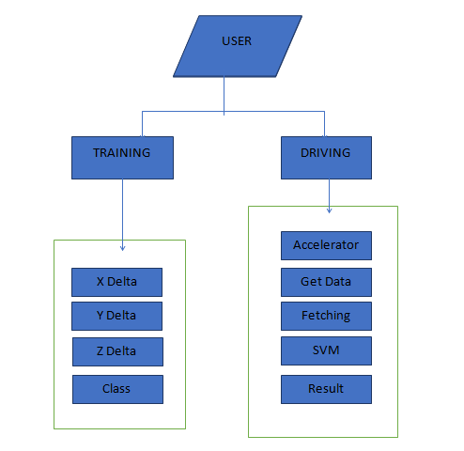
DFD:

Slide 13
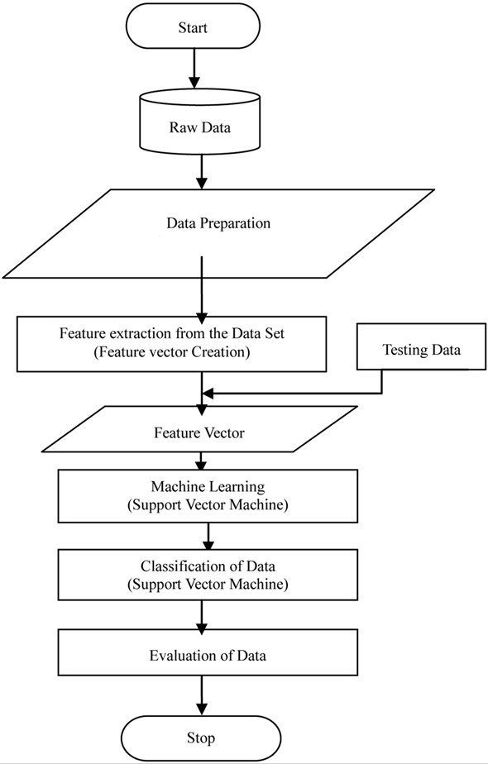
Flow chart:

Slide 14
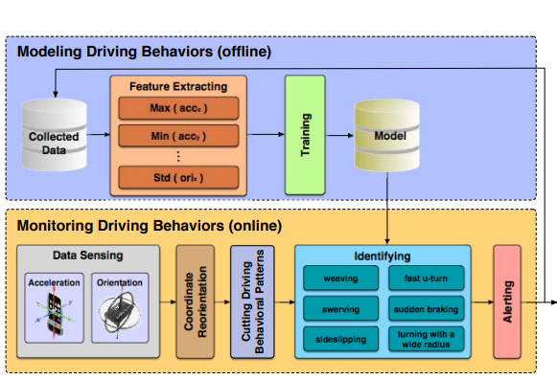
System Design

Slide 15
Modules
Collecting Data from Smartphone Sensors:
We develop an Android-based App to collect readings from the 3-axis accelerometer and the 3-axis orientation sensor. We align the two coordinate systems in the Smartphone and in the vehicle by making the accelerometer’s y-axis along the moving direction of the vehicle. Therefore, we could monitor the vehicle’s acceleration and orientation by retrieving readings from the Smartphone's accelerometer and orientation sensor.
Analyzing Patterns of Abnormal Driving Behaviors:
After high frequency noises are removed in the collected data using the low-pass filter, we can analyze the acceleration and orientation patterns of each type of abnormal driving behaviors. Let accx and accy be the acceleration on x-axis and y-axis, respectively. Let orixandoriy be the orientation on x-axis and y-axis, respectively

Slide 16
Low-pass Filtering:
Due to environmental dynamics, there are many high frequency noises in our collected raw data which has an impact on analyzing the dynamics of different driving behaviours. Thus we conduct low-pass filtering to the collected raw data first to remove the high frequency noise and yet capture the statistical features presented in the traces through dynamic exponential smoothing filter (DESF).

Slide 17
Sample code:
protected void onCreate(Bundle savedInstanceState) {
super.onCreate(savedInstanceState);
setContentView(R.layout.activity_main);
/*************************************/
b1=(Button)findViewById(R.id.button1);
b2=(Button)findViewById(R.id.button2);
b3=(Button)findViewById(R.id.button3);
/******************************************/
b1.setOnClickListener(new OnClickListener() {
public void onClick(View v) {
// TODO Auto-generated method stub
Intent login=new Intent(getApplicationContext(),manual.class);
startActivity(login);
}
});

Slide 18
b2.setOnClickListener(new OnClickListener() {
public void onClick(View v) {
// TODO Auto-generated method stub
Intent login=new Intent(getApplicationContext(),automatic.class);
startActivity(login);
}
});
/*********************************/
b3.setOnClickListener(new OnClickListener() {
public void onClick(View v) {
// TODO Auto-generated method stub
Intent login=new Intent(getApplicationContext(),manual.class);
startActivity(login);
}
});
}

Slide 19
protected void onCreate(Bundle savedInstanceState) {
super.onCreate(savedInstanceState);
setContentView(R.layout.automatic);
initializeViews();
sensorManager = (SensorManager) getSystemService(Context.SENSOR_SERVICE);
if (sensorManager.getDefaultSensor(Sensor.TYPE_ACCELEROMETER) != null) {
// success! we have an accelerometer
accelerometer = sensorManager.getDefaultSensor(Sensor.TYPE_ACCELEROMETER);
sensorManager.registerListener(this, accelerometer, SensorManager.SENSOR_DELAY_NORMAL);
vibrateThreshold = accelerometer.getMaximumRange() / 2;
} else {
// fai! we dont have an accelerometer!
}

Slide 20
protected void onCreate(Bundle savedInstanceState) {
super.onCreate(savedInstanceState);
setContentView(R.layout.view);
createDatabase();
t1=(TextView)findViewById(R.id.textView1);
t2=(TextView)findViewById(R.id.textView2);
t3=(TextView)findViewById(R.id.textView3);
t4=(TextView)findViewById(R.id.textView4);
t5=(TextView)findViewById(R.id.textView5);
t6=(TextView)findViewById(R.id.textView6);
Cursor c=db.rawQuery("SELECT count(cno) FROM drives where cno ='WAVE'", null);
int count=0;
if(c.moveToNext())
{
String d=t1.getText().toString()+c.getString(0);
t1.setText(d);
}

Slide 21
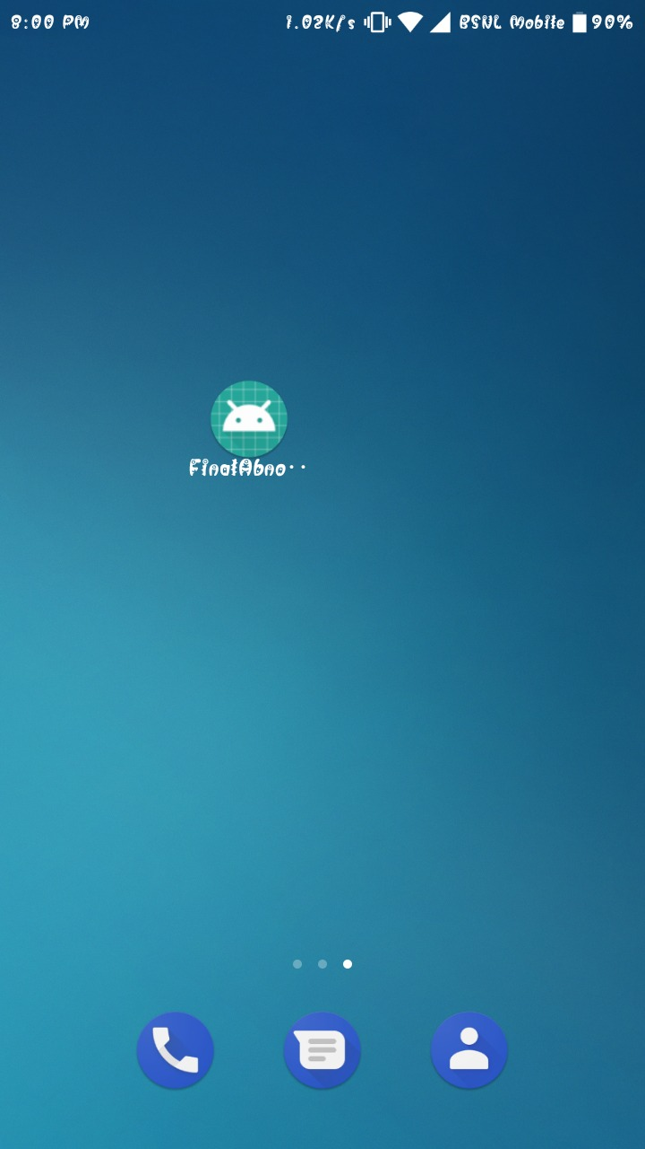
Screen shots:
Description:
The view of our application in the smart phone.

Slide 22
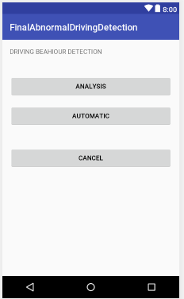
Description:
It consists of three buttons
1.Analysis- For analysing the driving behaviours
2.Automatic –For generating alerts when abnormality detected.
3.Cancel –To exit the application

Slide 23
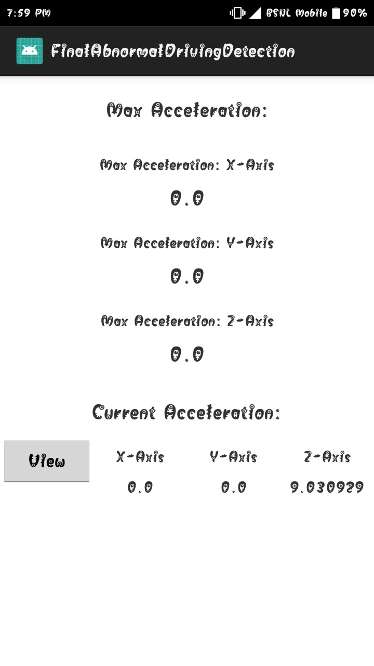

Slide 24
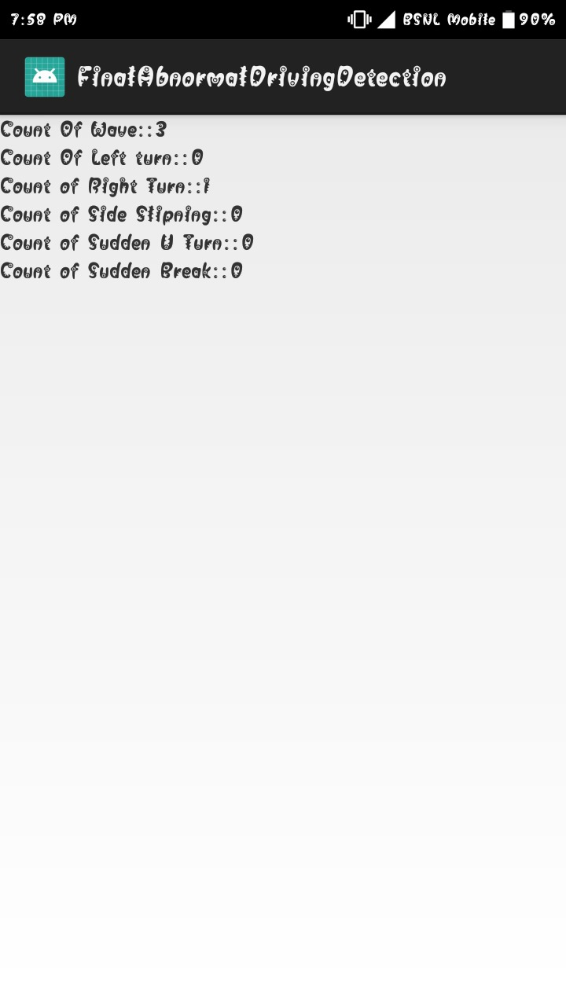

Slide 25
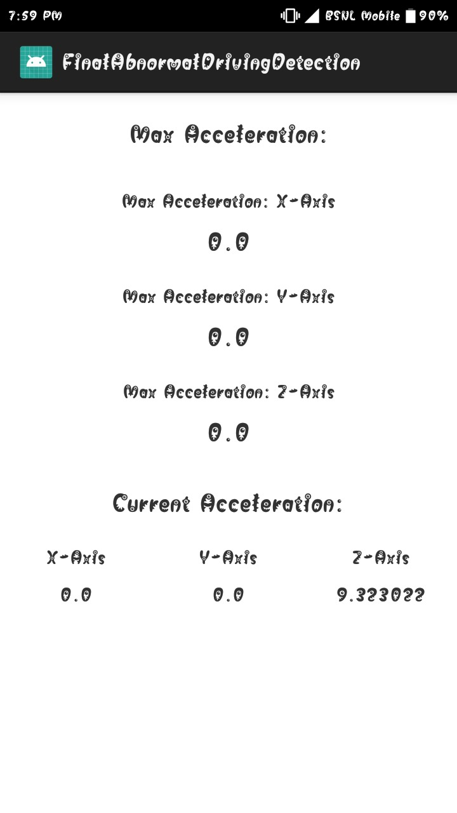

Slide 26
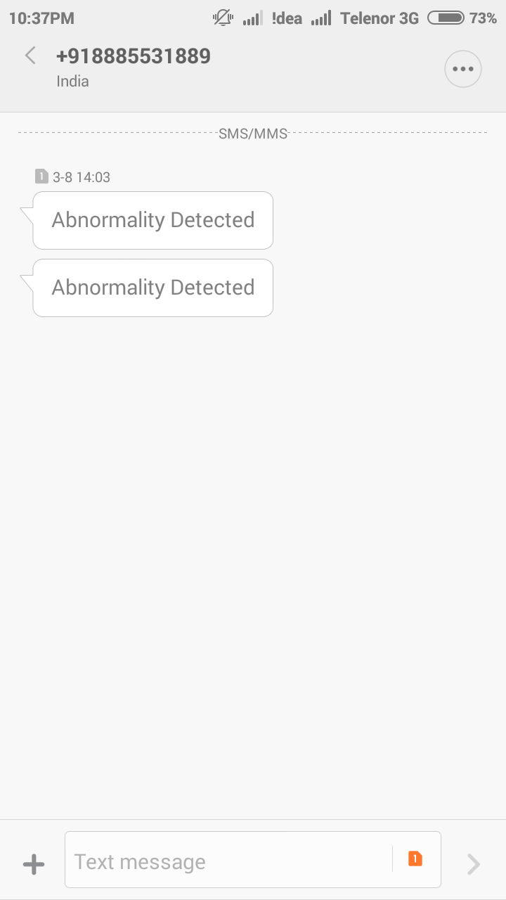

Slide 27
Future scope:
This project has a wide scope for development by including some extra features that is if the results of the monitoring could be passed back to a central server, they could be used by the police to detect drunken-driving automatically or Vehicle Insurance Company to analyze the policyholders’ driving habits.
Some important features are:
Impact of Training Set Size
Impact of Traffic Condition
Impact of Road Type
Impact of Smartphone Placement
Impact of Smartphone Sensors’ Sampling Rate

Slide 28
Conclusion:
We addressed the problem of performing abnormal driving behaviors detection (coarse-grained) and identification (fine-grained) to improve driving safety. In this different problems are reviewed from the existing work on smart phone driver behavior detection. Some problems are like to early detect abnormal driving status (e.g., drunk, fatigue, and drowsy) and those representation learning problems. Another problem is the lane positioning problems such as drifting and swerving. The second category is related to speed control problems such as sudden acceleration or erratic braking. All these problems are resolved in the future with the help of KNN, NN and SVM to improve the results.

Slide 29
Thank you

